Slide 1
Unit 1 Lesson 6 Practice Problems

Slide 2
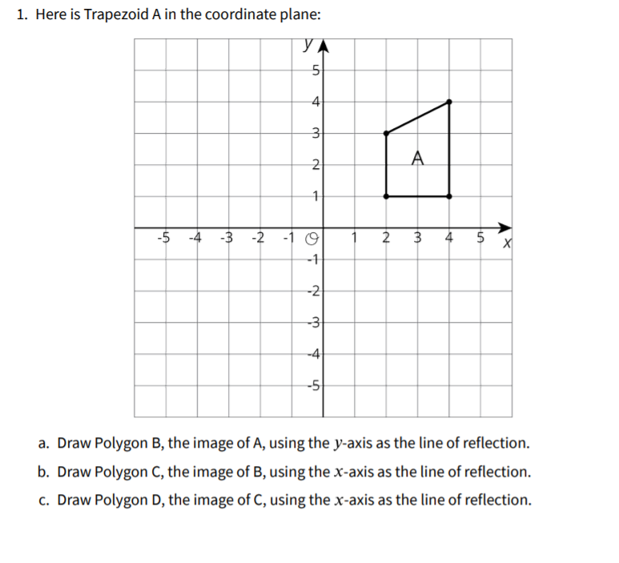

Slide 4
